Slide 1
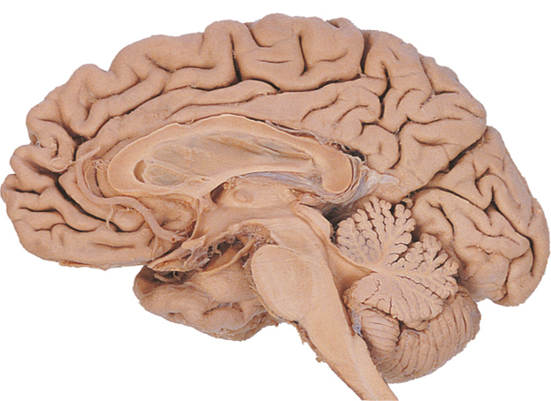

Slide 2
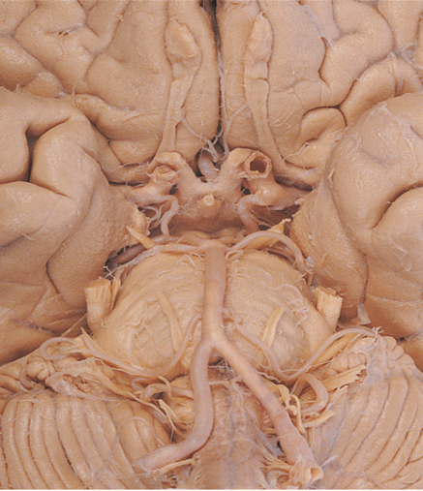










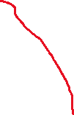

correct Circle of Willis (inferior view) set for Week 11 Langfield vascular supply
6
5
4
2
3
1

Slide 3
1.Basilar arterary
2. Middle cerebral arterty (MCA)
3.Posterior communicating artery
4. Posterior cerebral artery
5. Internal caratoid artery
6. Anterior cerebral artery (ACA)

Slide 4
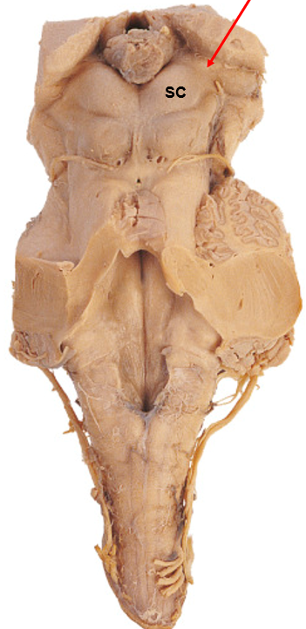
1
2
S
C
P
5
ICP
6
3
4

Slide 5
Inferior collicululus
2. Facial Colliculus
3. Cuneate Tubercle
Gracile Tubercle
5. Superior cerebellar Peduncle
6. Inferior cerebellar peduncle
Visual reflexes → Superior colliculus, Pretectal area
Auditory reflexes → Inferior colliculus
Somatosensory (fine touch) → Gracile + Cuneate nuclei/tubercles
Cranial nerve nuclei → Facial colliculus, Vagal/Hypoglossal trigones
Cerebellar connections → Peduncles (ICP, MCP, SCP)

